Slide 1
Module 3
Designing Strategies for Managers, HR Professionals and VET Providers to combat ageism and social exclusion at the workplace – Ireland – Future in Perspective

Slide 2
Unit 2: HRM strategies to address ageism and promote intergenerational working
By completing this unit, you will:
Understand the five key areas within Human Resource Management
Be able to describe how each of the five areas can result in individuals facing age related discrimination
Discuss and describe strategies that can be used within the workforce to promote intergenerational working.
Evaluate the policies that are in place within your own organisation to examine if they promote or discourage intergenerational working.

Slide 3
Unit 2: HRM strategies to address ageism and promote intergenerational working

Slide 4
The 6 HR Processes
There are six key areas within the workforce that management can address ageism related discrimination and social exclusion from the workforce:
Employer Branding
Recruitment & selection
Performance management
Learning & development
Succession planning & promotion
Compensation and benefits (including, pay and recognition)
Organisations need to ensure clear guidelines and strategies are in place that seek to eliminate against ageism, age-related bias, misconceptions and social exclusion occurring within the workforce.

Slide 5
Discussion: What are the major issues that you can identify that occur within these 6 areas?

Slide 6
Why Age Diversity is Good for Business

Slide 7
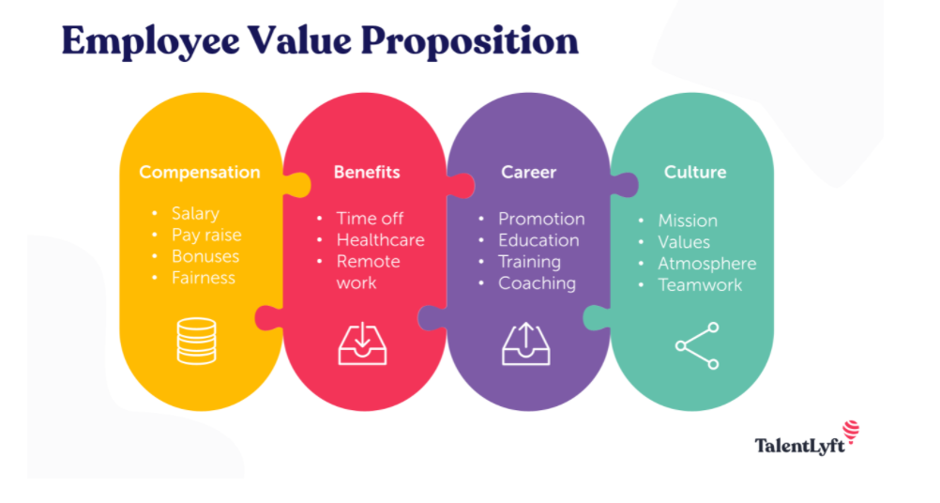
The 6 HR Processes
1. Employer Branding
Did you know that 59% of employers say that employer branding is one of the key components in their overall HR strategy (Doyle, 2020)?
All companies have an employer brand, whether they realise it or not!
The better the brand, or the reputation of an employer, the more likely they are to attract and retain the key people they need to grow their business.
Organisations that value diversity and inclusion off all ages can create a good Employee Value Proposition (EVP).
The EVP are the benefits that an employee can receive when working in a company, including;
Compensation
Benefits
Career
Work Environment & Culture

Slide 8
The 6 HR Processes
2. Recruitment & Selection
As people stay in the workforce longer, companies need to ensure they have policies in place that allow candidates of all ages to apply for the roles.
Stay clear of job descriptions that describe people as ‘experience’ and ‘seasoned’. Instead, seek those who have ‘high-potential’ and are ‘energetic’. [Source: Rockwood, 2018]
Advertising for ‘digital natives’ or only recent college graduates could result in age-discrimination against older persons.
During the interview process, ask questions that enable an individual to discuss their skillset, rather than their experience.
Psychometric tests are an excellent way to base candidates on their ability, rather than on their personality.

Slide 9
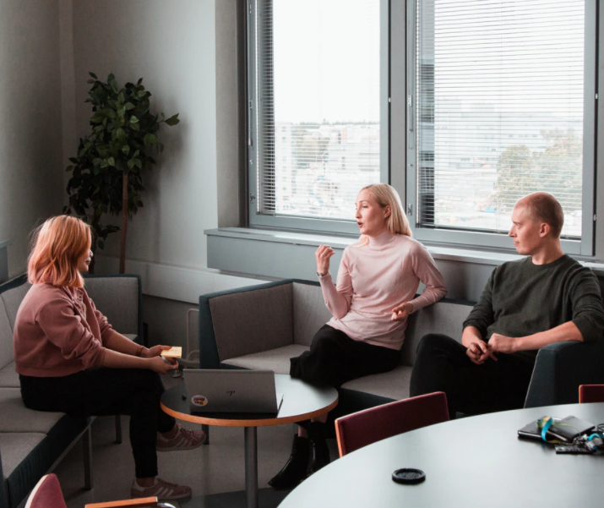
The 6 HR Processes
3. Performance Management
Performance management is a HR process that ensures that regular two-way communication occurs with supportive feedback, so that the employee can support the company to achieve their strategic objectives (CIPD, 2021).
HR should ensure that all employees are measured equally and afforded the same opportunities.
Performance can be measured through:
Reviews that occur monthly, bi-annually or annual.
360-degree feedback
Informal face-to-face conversations with management.

Slide 10
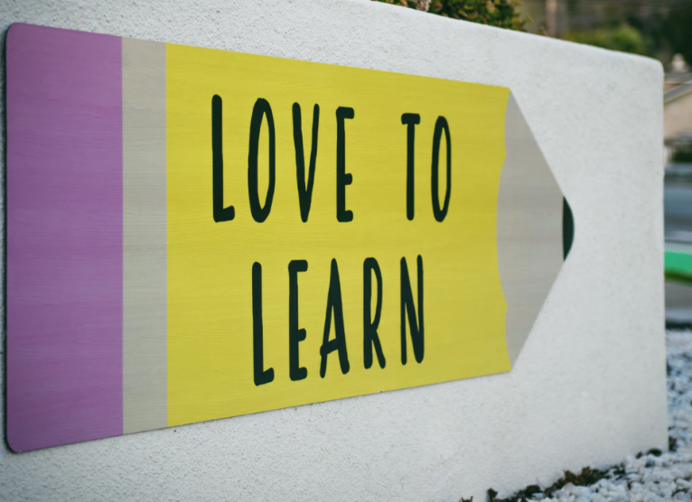
The 6 HR Processes
4. Learning & Development
Do assumptions exist within the workforce that younger members of staff cannot complete difficult tasks due to their age?
All members of the team should be offered the same learning and development opportunities, irrespective of their age or service duration.
Opportunities for learning and development should be offered based on skill, experience and talent.
Learning and Development opportunities will:
Reduce work place bias
Reduce common workplace myths such as those surrounding competencies
Increase intergenerational knowledge share
Increase empowerment of staff within the workforce
Improve the overall culture of the organisation

Slide 11
The 6 HR Processes
5. Succession Planning & Promotion
Succession planning is a process that enables an organisation to assess their current team and identify those who can be trained and developed to take more senior roles within the firm.
Succession planning can involve training up and promoting staff for new roles, or for roles that are being vacated by staff who may be retiring.
Traditionally, this process was highly confidential and highly structured, which resulted in key members of the team not being considered for more senior roles [CIPD, 2020.]
Nowadays, there has been a shift towards:
Creating a transparent atmosphere within the company;
Coaching those who are about to be promoted.
Sharing knowledge between team members
Empowering workers to make their own career decisions
There is also a need to consider those who are near retirement age.
Do they legally have to retire, or, are they being forced out of the company due to their age?
Consider having a conversation with an older member of staff to plan for their exit from the company, assess their needs and see how they can share their knowledge with younger members of staff.

Slide 12
The 6 HR Processes
6. Compensation and benefits
Based on the Total Rewards Model (2000), compensation can either be:
Direct: A wage or a salary, and additional benefits such as allowances, health care and free food.
Indirect: achieving a work-life balance, being recognised by colleagues and management, having opportunities for career development.
Compensation needs to be distributed fairly with measures in place to determine how it is distributed.
Generational differences occur within the compensation and benefits process:
Older people are looked at as being more expensive
Younger people may need more training to match the skillset of older workers.

Slide 13
Strategies to combat ageism and social exclusion at the workplace

Slide 14
Strategies to combat ageism and social exclusion at the workplace
The EU Council Directive 2000 / 78 / EC
Article 6 of the Treaty on the European Union recognises and respects the fundamental rights of all individuals.
EU Council Directive 2000 / 78 / EC establishes a framework for equal treatment of all individuals within employment and occupation.
This Directive also stresses the need to support older workers in the workforce and to combat age related discrimination and social exclusion that occurs.
Discriminating against an individual across Europe based on their age is illegal based on this directive.
EU Member States are required to be compliant with this Council Directive, and any laws that were in place prior to this and in breech of the directive were required to be abolished.
All EU Member States have enacted their own legislation to ensure that this Council Directive is followed.

Slide 15
Strategies to combat ageism and social exclusion at the workplace
The Equal Status Acts 2000 – 2018 (Ireland)
Under the Equal Status Acts 2000 – 2018, people are protected against discrimination under nine grounds including age and gender.
The Acts ensure that all people have access to the same goods and services, such as accommodation, education and work without being discriminated against.
Companies should have policies in place that protect all individuals from discrimination, or less favourable treatment within the workplace (Citizens Information, 2021).
Consider the Employee Handbook of your organisation:
Does it address age discrimination?
If not, consider adding a statement to say that ‘our company respects employees of all ages by doing …. ‘
Individuals who feel that they have been discriminated against can seek assistance from:
The Irish Human Rights and Equality Commission: https://www.ihrec.ie/about/contact/
The Workplace Relations Commission: https://www.workplacerelations.ie/en/contact_us/contact-details/

Slide 16
Strategies to combat ageism and social exclusion at the workplace
The Remote Working Checklist for Employers
Since the onset of the COVID-19 pandemic, many people have been forced to work involuntarily from home.
Organisations have a duty of care towards their employees under a wide range of issues including:
Health and Safety;
Employment Conditions;
Data Protection;
Equality and Training;
The Government of Ireland created the Remote Working Checklist for Employers which can inform managers of measures they need to put in place to protect their staff.
Some of the measures include;
Social interactions for employees;
Mental Health and Wellbeing supports;
Equality Issues
The Remote Working Checklist for Employers can be found here: https://enterprise.gov.ie/en/Publications/Publication-files/Remote-Working-Checklist-for-Employers.pdf

Slide 17
Strategies to combat ageism and social exclusion at the workplace
Addressing Stereotypes within the Workforce
The US Equal Employment Opportunity Commission (EEOC) have identified four strategies that can be implemented within any workforce across the globe to combat ageism and social inclusion within the workplace.
Source: Janove (2019)
Assess:
Examine
Include
Foster
What is the culture of the organisation?
What policies and practices are in place?
Are there negative assumptions towards younger or older people within the organisation?
What does your employer branding say about your company?
Are you attracting an age-diverse workforce?
Does the interview process breech Equality Legislation?
Be open and honest about age in policies and training programmes.
Offer opportunities for learning and development to all.
Reject negative stereotypes.
Promote a safe, age-diverse culture within the organisation.

Slide 18
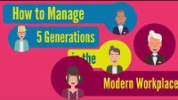
Strategies to combat ageism and social exclusion at the workplace
Proactively Managing Age Diversity
Did you know, in 2014, there were 3 times more older people than younger people who were not engaged in education, employment or training (ONS 2014)?
The ‘Proactive Management of Age Diversity’ Strategy enables organisations to harness the strengths of both groups of workers and share knowledge and expertise between them.
By promoting diversity and inclusion, through understanding each of the generational cohorts, teams are able to thrive.

Slide 19
Strategies to combat ageism and social exclusion at the workplace
Age Friendly Service Provision
Age Friendly Ireland offers a programme that allows organisations and towns across the country to be better prepared and equipped for an aging population or for those with additional needs.
In being Age Friendly, organisations must examine their internal policies, procedures and even facilities to gain a better understanding of how they can adapt to generational change.
Age Friendly organisations enables individuals of all ages to access anything they wish to do with no physical or societal barriers in place.
Examples include:
Social infrastructure
Accommodation
Transport

Slide 20
Strategies to combat ageism and social exclusion at the workplace
Optimisation, Selection and Compensation
Stanimira et al. (2016) advocated for and proposed three intertwined strategies that a workplace can adapt to ward off age related discrimination.
The three strategies include:
Optimisation
Selection
Compensation
Optimisation
Improve individuals through offering them a range of Training and Development Opportunities
Selection
Choose the best staff and onboard them.
Encourage staff to prioritise their workload.
Compensation:
Pay and reward staff in line with their achievements.

Slide 21
Mentoring and Reverse Mentoring
Traditionally, organisations match older people with younger people to mentor them to create knowledge transfer.
Universities in Ireland offer a mentorship programme, where alumni volunteer their time and support students in their second year of studies with any work related questions they may have.
Reverse mentoring has flipped traditional mentoring on its head and encourages younger workers to empower older workers to stay relevant in their field.
Microsoft is known for offering Reverse Mentoring within the workforce:
Younger workers gain valuable knowledge in leadership;
Older workers learn a wide range of skills that come natural to digital natives and can learn about trends that are happening

Slide 22
Defining the Retirement Age
Here are some questions to consider?
How old is the retirement age in your country?
Is there a compulsory or voluntary retirement age in your country?
Do workers know their legal obligations around their retirement?
To ensure that older workers are aware of their requirements around retirement, be sure to document it in employee contracts and handbooks.
Failing to communicate a compulsory retirement age could result in challenges for an organisation when employees then refuse to leave.
When defining the retirement age, be sure to identify solid reasons for this.

Slide 23
Identify how you can implement one of these strategies into your organisation to combat ageism?

Slide 24
Always remember to document all decisions made in case an employee takes legal action on the grounds of age discrimination.

Slide 25
References
Newmanity School (2018) Why Age Diversity is Good for Business. Retrieved from: https://www.youtube.com/watch?v=hG5BB8Ope_E
Rockwood, K. (2018) Hiring in the Age of Ageism: https://www.shrm.org/hr-today/news/hr-magazine/0218/Pages/hiring-in-the-age-of-ageism.aspx
CIPD (2020) Performance Management. Retrieved from: https://www.cipd.ie/news-resources/practical-guidance/factsheets/performance-management#gref
CIPD (2020) Succession Management. Retrieved from https://www.cipd.ie/news-resources/practical-guidance/factsheets/succession-planning#gref
World at Work (2000) Total Rewards Model. Retrieved from: https://www.worldatwork.org/docs/marketing/1610_BRO_TRModel_Update_J5613_FNL.pdf
The Irish Human Rights and Equality Commission (2021) The Equal Status Acts. Retrieved from: https://www.ihrec.ie/guides-and-tools/human-rights-and-equality-in-the-provision-of-good-and-services/what-does-the-law-say/equal-status-acts/

Slide 26
References
• Citizens Information (2021) equality in the workplace. Retrieved from: https://www.citizensinformation.ie/en/employment/equality_in_work/equality_in_the_workplace.html
The Government of Ireland (2021) Remote Working Checklist for Employers. Retrieved from: https://enterprise.gov.ie/en/Publications/Publication-files/Remote-Working-Checklist-for-Employers.pdf
Janove, J. (2019) How to avoid ageism. Retrieved from: https://www.shrm.org/hr-today/news/all-things-work/Pages/how-to-avoid-ageism.aspx
Equinet, the European Network of Equality Bodies (2011) Tackling ageism and Discrimination. Retrieved from: http://www.healthyageing.eu/sites/www.healthyageing.eu/files/resources/age_perspective__merged____equinet_en.pdf
CIPD (2015) Managing an age-diverse workforce: What employers need to know. Retrieved from: https://www.cipd.co.uk/Images/managing-an-age-diverse-workforce_2015-what-employers-need-to-know_tcm18-10832.pdf
Bython Media (2018) How to manage 5 generations in the modern workplace. Retrieved from: https://www.youtube.com/watch?v=gmzgfJl40hQ
Centre for Ageing Better (2017) What does age-friendly mean to you? Retrieved from: https://www.youtube.com/watch?v=xD36Js5jLeI
Doyle, O. (2020) 5 examples of companies doing employer branding right. Retrieved from: https://www.occupop.com/blog/5-examples-of-companies-doing-employer-branding-right

